Slide 1

CASE STUDY-5
TOYJOY
Retail Inventory Management
&
Sales Performance Analysis

Slide 2
1.Introduction
ToyJoy is a toy retail company that manages inventory across multiple warehouses and suppliers.
        The company sells different categories of toys including:
          Action Figures
          Educational Toys
          Board Games
          Dolls
          Puzzles
          Remote-Control Toys
The management wanted to improve inventory tracking, reduce stock shortages, and optimize product performance.

Slide 3
2. Business Problem
      ToyJoy faced several operational challenges:
      Overstock and understock issues
      Difficulty tracking fast-selling products
      Delayed reordering decisions
      Inventory imbalance across warehouses
      Lack of real-time inventory visibility

Slide 4
3.OBJECTIVES
The main objectives of this analysis were:
          Monitor inventory levels
          Identify top-selling products
          Analyze warehouse stock distribution
          Improve reorder planning
          Reduce stock shortages and excess inventory

Slide 5
          4.Dataset Overview
              The dataset contains:
                Product ID
                Product Name
                Category
                Supplier
                Warehouse
                Stock Quantity
                Unit Price
                Reorder Level
                Units Sold Last Month
                Product Rating

Slide 6
          5. Key KPIs
              Inventory KPIs
                Total Inventory Stock
                Total Sales Units
                Low Stock Products
                Reorder Requirement
                Average Product Rating
                Inventory Value
                Top Selling Products
                Warehouse-wise Inventory

Slide 7
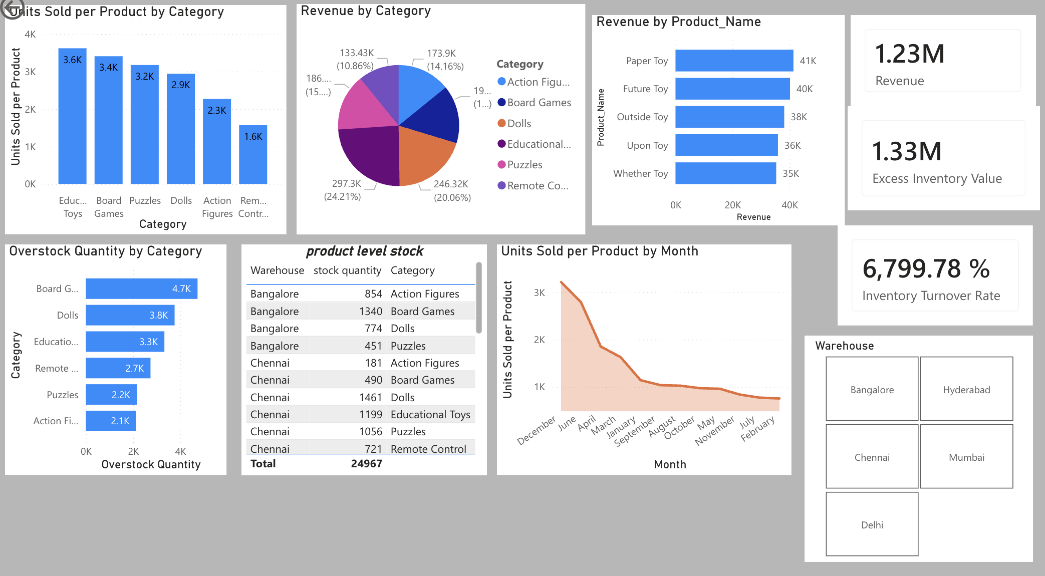
5.1.DASHBOARD SUMMARY

Slide 8
                6.Dashboard Features
                Interactive Dashboard Components
                KPI Cards
                Inventory Trend Charts
                Warehouse-wise Analysis
                Product Category Breakdown
                Top Selling Products Table
                Supplier Performance Analysis
                Low Stock Alerts
                Slicers for Category & Warehouse

Slide 9
7. Key Insights
          Educational Toys generated the highest sales.
          Some warehouses had excess inventory while others faced shortages.
          Fast-moving products required frequent reordering.
          Products with higher ratings had better sales performance.
          A few suppliers consistently delivered top-selling products.

Slide 10
8. Recommendations
    8.1.Quick Wins
          Restock low inventory products immediately
          Transfer excess stock between warehouses
          Focus promotions on high-rated products
    8.2.Long-Term Strategies
          Implement automated reorder alerts
          Use demand forecasting
          Improve supplier relationship management
          Optimize warehouse distribution

Slide 11
          9.Business Impact
              After implementing the dashboard:
              Inventory visibility improved significantly
              Stock shortages were reduced
              Reorder decisions became faster
              Sales tracking became more accurate
              Inventory costs were optimized

Slide 12
          10. Conclusion
              This case study demonstrates how Microsoft Power BI can help retail businesses transform inventory data into actionable insights.
              The dashboard enabled ToyJoy to:
              Improve inventory efficiency
              Optimize stock management
              Increase operational productivity
              Support data-driven business decisions

